Slide 1

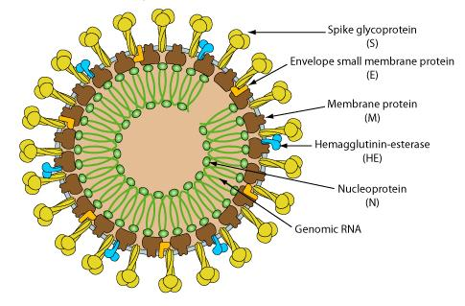
NIGERIAN SOCIETY FOR
IMMUNOLOGY
2021-
World immunology day
THEME: MATTERS ARISING ON COVID-19 IMMUNITY
Lecture Topics
State of NSI:
- Prof. A.A. Okerengwo & Prof G.O. Oyeyinka
Acquisition of immunity to COVID-19:
- Prof. O.G Arinola
Current issues on vaccines in the prevention of COVID-19:
- Prof. M. Tatfeng

Slide 2
ACQUISITION OF COVID-19 IMMUNITY :
ANY HOPE FOR HERD IMMUNITY?
Professor O. G. Arinola
Department of Immunology
College of Medicine
University of Ibadan
2021-World immunology day

Slide 3
ACQUISITION OF COVID-19 IMMUNITY
a.Immunity to Natural Infection
b. Vaccination
c. Herd Immunity
2021-World immunology day

Slide 4
Introduction
COVID-19 is caused by a single stranded RNA virus - SARS-CoV-2
The virus has 4 major structural proteins:
  Spike (S)
  Membrane (M)
  Envelope (E) and
  Nucleocapsid (N)
2021-World immunology day

Slide 5
Importance of envelope proteins
The S protein mediates attachment to the host receptor.
The M protein with 3 transmembrane domains, is thought to give the virion its shape and promote membrane curvature or binding to the nucleocapsid.
The E protein has ion channel activity required for pathogenesis, facilitates assembly and release of the virus.
The N protein binds nsp3, a key component of the replicase complex.
2021-World immunology day

Slide 6
The 4 structural proteins & its life cycle are important in understanding the immune responses and in designing preventive & therapeutic strategies against the virus.
Briefly;
  SARS-CoV-2 attaches to epithelia cells of the host using the S protein through ACE-2 receptor
  In the host cell cytosol, S protein is cleaved by cathepsin or other proteases
  Replication and transcription of the sub-genomic RNAs
  Translation and
  Assembly of the viral replicase complexes.
2021-World immunology day

Slide 7
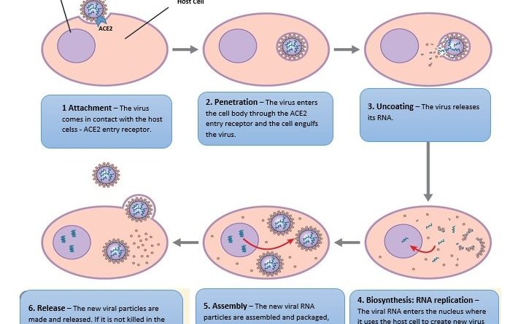
2021-World immunology day

Slide 8
ACQUISITION OF COVID-19 IMMUNITY
a. Immunity to Natural Infection
- Innate Immunity
- Adaptive Immunity
2021-World immunology day

Slide 9
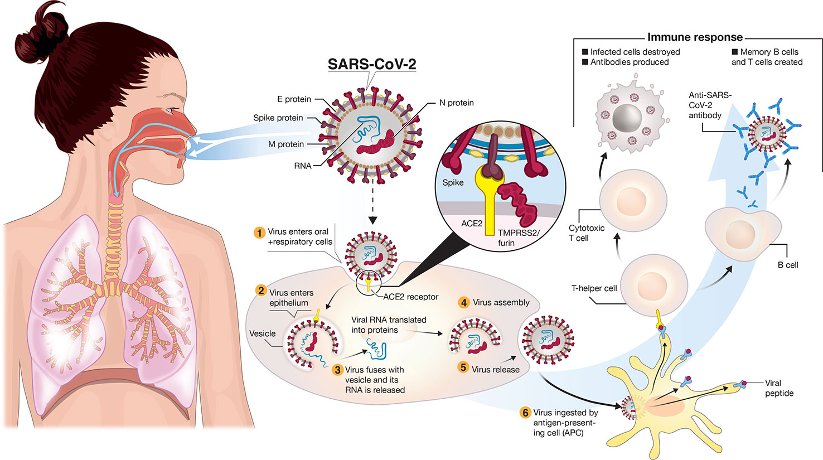
RELATING SARS-CoV-2 INFECTION CYCLE WITH HOST IMMUNE RESPONSES
2021-World immunology day

Slide 10
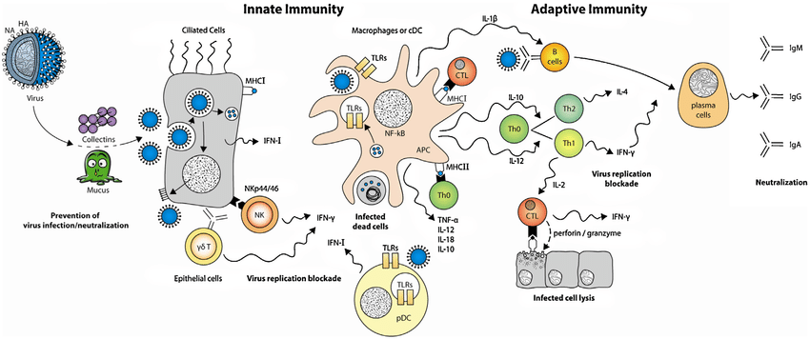

Brief Overview Of COVID-19 Host Immune Responses
2021-World immunology day

Slide 11
Brief Overview Of COVID-19 Host Immune Responses
INNATE IMMUNE RESPONSES:
  Muco-ciliary movements
  Nasal cilia filtration
  Mucus trapping action
  nose-mask as a physical barrier
Sneeze out or Ingest for the action of stomach pH (Stool screening for viral particles).
Pattern Recognition Receptors (PRRs) of innate immune cells detects dsRNA (a Pathogen‐Associated Molecular Patterns, PAMPs)of the virus.
PRRs such as Toll-like receptors 2, TLR 4, mannose receptor, scavenger receptor; mannose-binding lectin and C-reactive protein.
NF-kB activation
  promotes synthesis of type I IFNs and other pro-inflammatory cytokines
2021-World immunology day

Slide 12
Type I IFNs are antiviral proteins which:
  Protect uninfected cells,
  Limit virus spread, and
  Enhance:
    Macrophage phagocytosis,
    NKC,
    T lymphocytes and
    B lymphocytes- functions
2021-World immunology day

Slide 13
Pro-inflammatory cytokines (IL-1, IL-6, IL-8, TNF-β and MCP-1)
  Attract,
  Retain and
  Activate lymphocytes and leukocytes to the site of infection
  This stage is thus associated with:
    High fever,
    Hypoxemia,
    Progression to pneumonia-like symptoms, and
    Progressive decline in virus titres
2021-World immunology day

Slide 14
ADAPTIVE IMMUNE RESPONSE
Alveolar macrophages (AM) & nerve/airway associated-macrophages (NAM) present viral peptides to B- and T- lymphocytes
Production/activation of:
  Antibody-secreting cells,
  Follicular helper T cells,
  CD4⁺ and CD8⁺ T cells,
  Immunoglobulins
2021-World immunology day

Slide 15
VIRAL EVASION OF IMMUNE RESPONSES
Early and massive production of multiple proteins that inhibit IFN response
Induction of T cells apoptosis
Induction of lung epithelial/endothelial cell apoptosis and alveolar edema resulting in hypoxia
  This may be one of the ways by which SARS-COV-2 leaks to blood circulation
2021-World immunology day

Slide 16
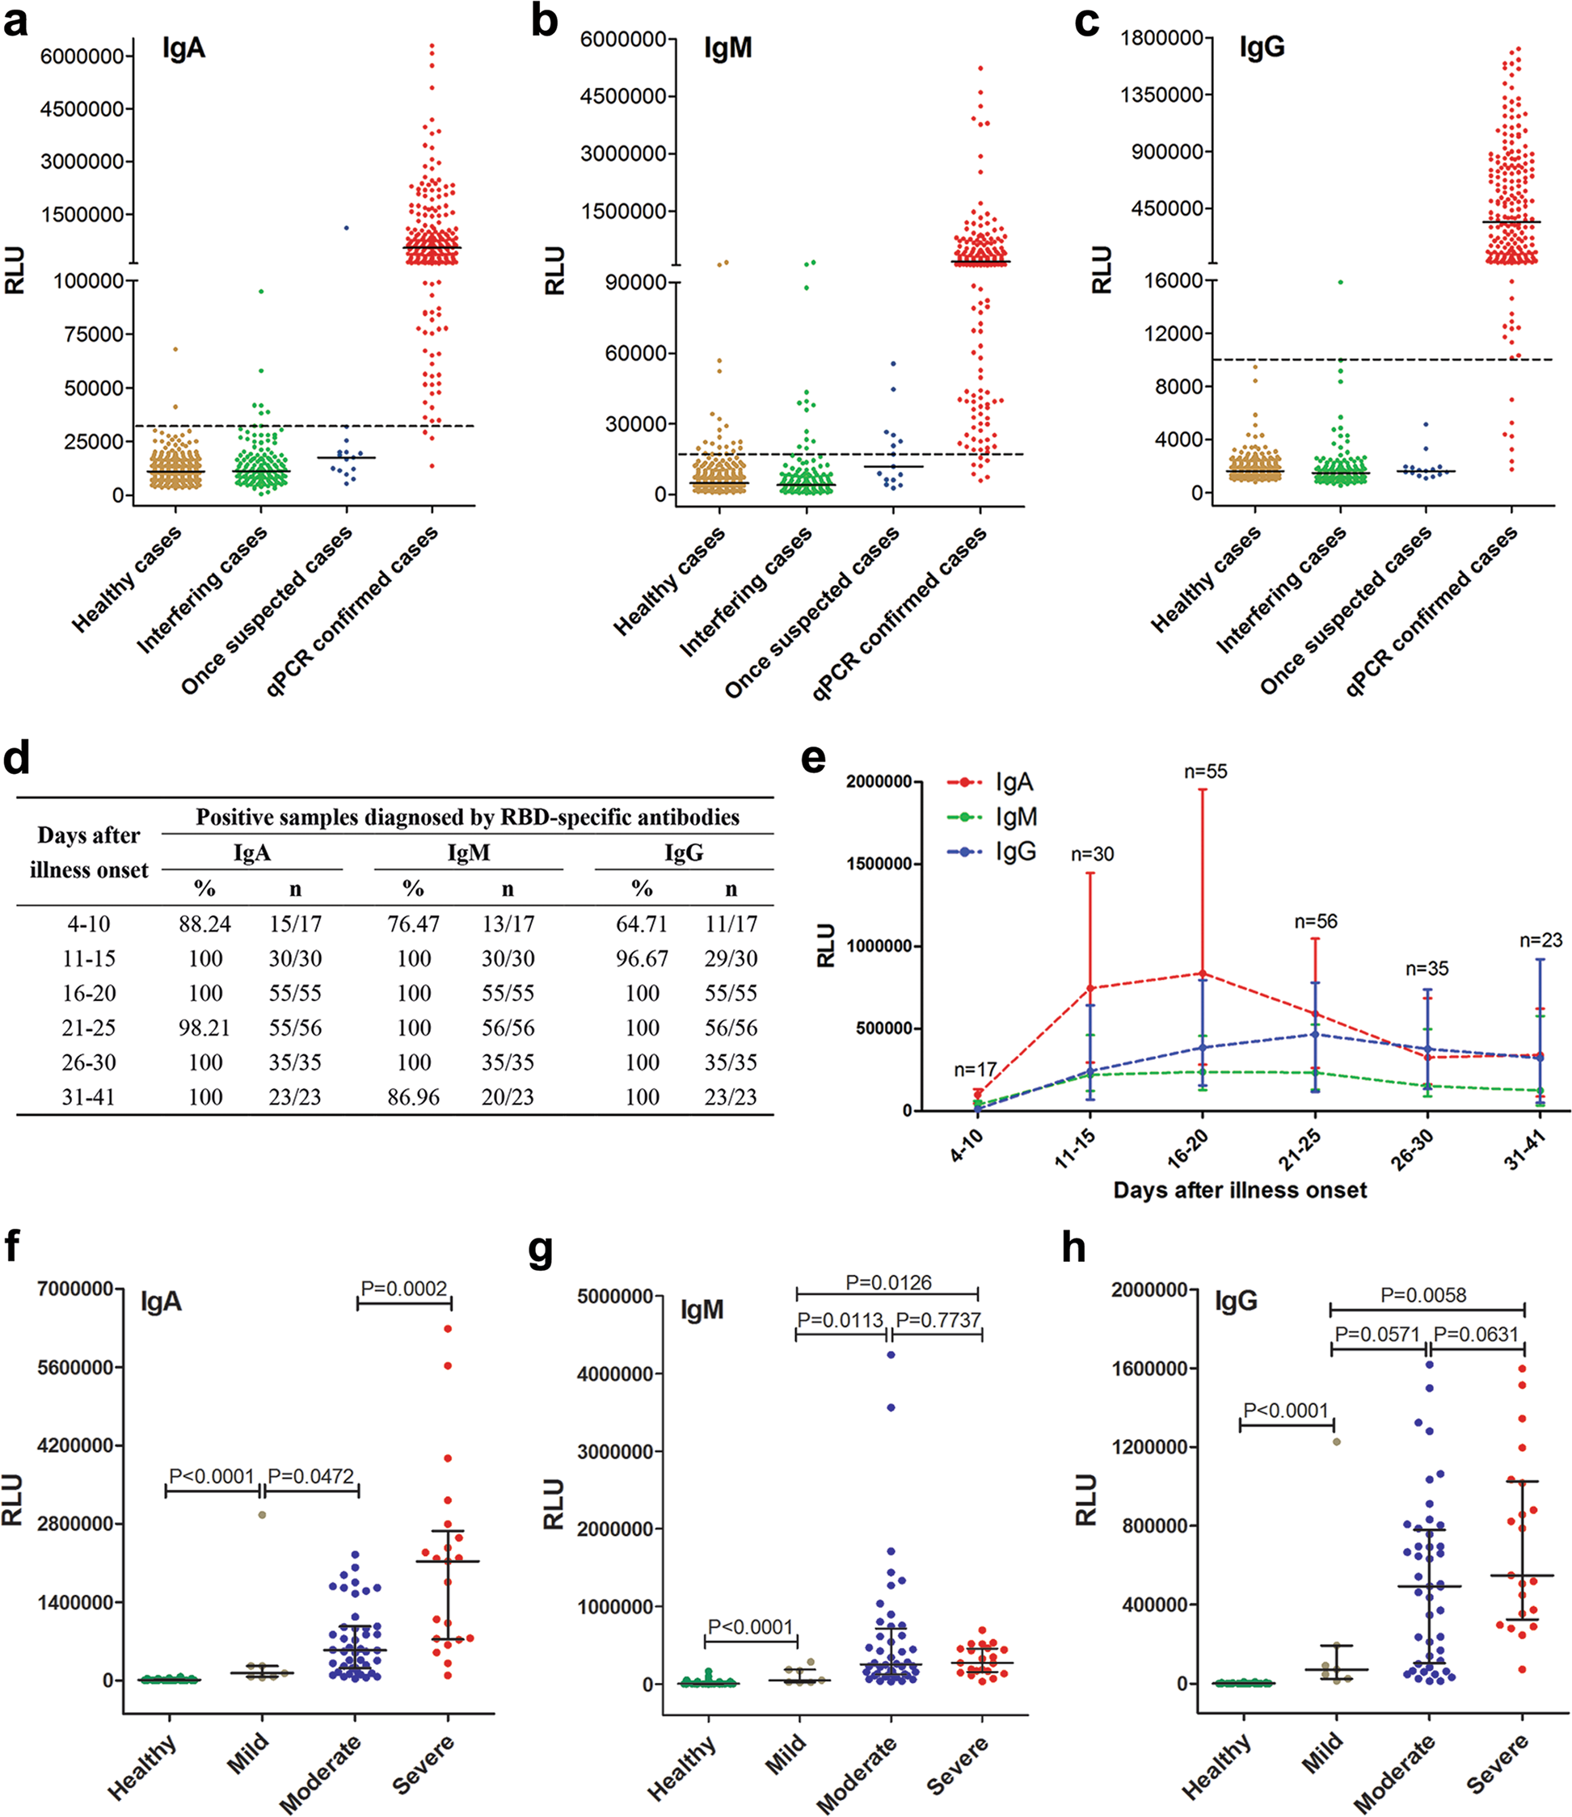
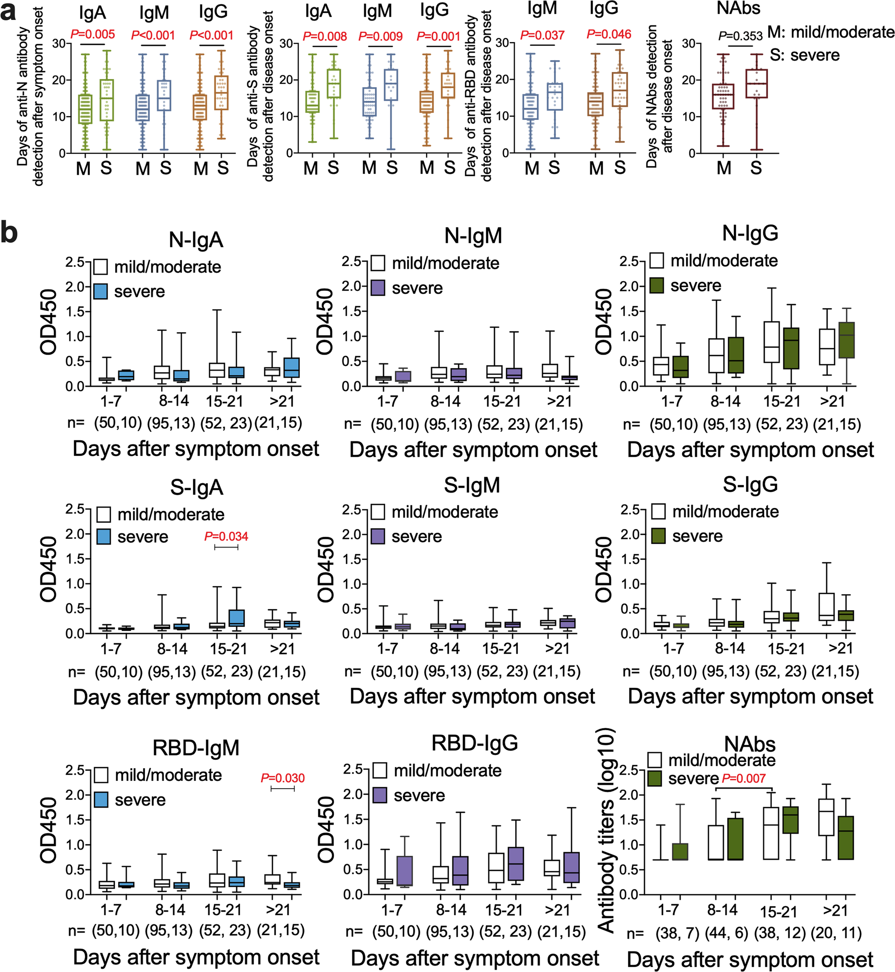
DAYS OF ANTIBODY DETECTION POST ONSET OF COVID
2021-World immunology day

Slide 17
SELECTED OUTCOMES OF COVID-19 STUDIES IN THIS ENVIRONMENT
Study in one Infectious Disease Center in Ibadan, Nigeria concluded that
  high proportion (84.3%) of the patients spent less than 14 days on admission.
  COVID-19 was common among male Nigerians,
  In those working in private establishment
  and aged 18-35yrs.
  (G.O. Arinola, O.A. Fashina, O.C. Oluyomi Ishola, O.I. Akinbola, S.A. Akinbile, A.O. Eegunjobi, M.D. Bello, F.V. Edem, S.K. Rahamon, O.I. Famuyiwa, A.J. Olaoti, O.A.Olaniyan, A.C. Oke, A. Fowotade, O. Abimbola, J.O. Johnson, O.S. Fagbemi, Funmi Salami, T.O. Alonge (2021). Demographic attributes of COVID-19 patients in an infectious disease center of Nigeria. Afr. Journal of Clinical and Experimental Microbiology. 22(1): 21-27).
2021-World immunology day

Slide 18
SELECTED OUTCOMES OF COVID-19 STUDIES IN THIS ENVIRONMENT
Factors of respiratory burst which are components of the innate immune system are altered in COVID-19 patients and could be involved in the immune-pathogenecity of SARS-CoV-2
MPO coupled with NO may explain differential severities of COVID-19 among genders and age groups.
(Ganiyu Olatunbosun Arinola, Fabian Victory Edem, Temitope Oluwagbenga Alonge. (2021). Respiratory Burst Functions in COVID-19 Nigerian Patients. Journal of Basic and Applied Research in Biomedicine. In Press)
2021-World immunology day

Slide 19
SELECTED OUTCOMES OF COVID-19 STUDIES IN THIS ENVIRONMENT
Plasma hs-CRP level might be a useful prognostic marker of COVID-19.
Also COVID-19 in Infectious Disease Centre exhibited low-grade inflammation.
(Arinola O.G, VF. Edem and Alonge T.O. (2020). Levels of Plasma C-Reactive Protein, Albumin and Pre-Albumin in COVID-19 Nigerian Patients. Annals of Medical Research. In Press).
2021-World immunology day

Slide 20
SELECTED OUTCOMES OF COVID-19 STUDIES IN THIS ENVIRONMENT
The level of CovIgG was significantly higher in COVID-19 patients at discharge compared with the level at admission while the level of CovIgM was insignificantly reduced in COVID-19 patients at discharge compared with the level at admission.
The data from this study indicates increased anti-SARS-COV-2 IgG Spike antibody in symptomatic COVID-19 at discharge, thus providing basis for antibody-based therapies to treat COVID-19 patients.
  (Ganiyu Olatunbosun Arinola (2021). Serum Levels of Anti-Corona Virus Specific-IgG and -IgM Antibodies in COVID-19 Patients At Admission and At Discharge. European Journal of Clinical and Experimental Medicine. 19(1): 5-9).
2021-World immunology day

Slide 21
SELECTED OUTCOMES OF COVID-19 STUDIES IN THIS ENVIRONMENT
Cassette system lateral flow immunoassay has limited use for screening anti-SARS 2 -IgG and -IgM antibodies in COVID-19 patients
and that these antibodies are more prevalent in COVID-19 patients at discharge than those newly diagnosed,
thus not all plasma from COVID-19 patients should be consider for plasma therapy.
  (Ganiyu O. Arinola, AbdulFattah A. Onifade, Fabian V. Edem and Surajudeen A. Yaqub (2021). Detection of anti SARS-COV 2 specific -IgG and -IgM antibodies in COVID-19 patients using rapid screening immunochromatographic cassettes. Annals of Epidemiology and Public Health. 4(1): 1059).
2021-World immunology day

Slide 22
SELECTED OUTCOMES OF COVID-19 STUDIES IN THIS ENVIRONMENT
The proportion of participants with anti-SARS-CoV-2 IgM antibody identified using ELISA was significantly higher compared with RDT.
In contrast, the proportion of participants with positive anti-SARS-COV-2 IgG antibody identified using RDT was significantly higher compared with ELISA.
ELISA has a better sensitivity for detecting anti-SARS-CoV-2 Spike-protein specific antibodies than the RDT. However, combination of RDT and ELISA for the detection of anti-SARS-COV-2 antibodies might be useful for population COVID-19 screening.
  (Arinola O.G, Edem V.F, Rahamon S.K, Yaqub S.A, Fashina A.O and Alonge T.O. (2020). SARS-CoV-2 Infection Screening Using Two Serological Testing Methods. Nigerian. J. Physiol. Sci. 35 (December 2020): 117 – 121).
2021-World immunology day

Slide 23
ACQUISITION OF COVID-19 IMMUNITY
b. Vaccination
2021-World immunology day

Slide 24
COVID-19 VACCINATION
Vaccine design is fuelled by proper understanding of host immune responses to a particular pathogen
Main aim of vaccines-
  Stimulate immune responses so that the body can develop memory B and T cells against actual infection
  Generally, good vaccines must:
    be safe to administer,
    produce the appropriate type of immunity (antibody and/or cell-mediated) for the disease in question,
    be inexpensive for the target population
    take into account geographical, gender and age differences.
Although there are some overlap, each COVID-19 vaccine has distinct advantages and disadvantages
Types of COVID-19 Vaccines: Active and Passive.
2021-World immunology day

Slide 25
Types of Covid-19 Vaccines: Active and Passive
1. Active Immunity (Vaccination)
DNA Vaccine (Inovio)
RNA Vaccine (Moderna, Pfizer)
Viral Vector (Oxford/AstraZeneca, CanSino Biologics, Janssen
Viral Subunit (Novavax, AdaptVac, Clover)
Live Attenuated (Codagenix, Indian Immunologicals Ltd.)
Inactivated Virus (SinoVac, SinoParm)
VPL (Virus Like Particles )
Split Virus Vaccines (e.g. Flu Vaccines)
RNP (Ribonucleoprotein) Vaccine.
2021-World immunology day

Slide 26
2. Passive Immunity (Antibody Administration)
Antibodies
Monoclonal Antibodies (e.g. Bamlanivimab)
Polyclonal Antibodies (e.g. Regeneron)
Convalescent Plasma
mRNA Induced Antibody (M.I.T.)
2021-World immunology day

Slide 27
BRIEF MECHANISM OF ACTIVE VACCINES
Sequences, synthesised or part of Active substance
  e.g. Spike protein of SARS-COV-2
Produced antigen is displayed on the cell surface
Sequenced, synthesised or part of ACTIVE SUBSTANCE (DNA/mRNA) is delivered into the body inside a substance (Plasmid/LNP) to ensure safe delivery
Active substance is taken up by host cells to produce the antigen of interest
Antigen stimulates antibody and T cell responses
2021-World immunology day

Slide 28
COVID VACCINES & THEIR ACTIVE SUBSTANCES
DNA Vaccines Gene that codes for viral protein
RNA Vaccines mRNA template for viral protein
A harmless Virus Vector transports Virus gene
Viral Sub-Unit Vaccines Virus Surface Proteins
Split Virus Vaccine Cut Pieces of the actual virus
Virus like Particles (VLP) Vaccines Virus Like Particles without the Genetic
Viral Vector Vaccines
Protein Vaccines
2021-World immunology day

Slide 29
Viral Vaccines
Live Attenuated Vaccines Weakened Actual Virus
Inactivated Vaccines Virus killed by heat/chemicals
2021-World immunology day

Slide 30
DNA Vaccines
Made up of small strands of DNA (a gene) encoding the antigen of interest
  e.g. Spike protein of SARS-COV-2
Produced antigen is displayed on the cell surface
The gene is attached to a plasmid for delivery into the body
Plasmid is used so that the body does not degrade the foreign gene before it provokes an immune response
Foreign gene taken up by host cells to produce the antigen of interest
Antigen stimulates antibody and T cell responses
2021-World immunology day

Slide 31
RNA Vaccines
Consist of an mRNA encoding the antigen of interest e.g. S-protein
After the mRNA is taken up by the host cells, intra-cellular lipases degrade the LNP exposing the mRNA
mRNA is placed in a Lipid Nanoparticle (LNP) vehicle
LNP prevents the mRNA degradation by the host until it is taken up by the cell
mRNA is then translated into antigen of interest & displayed on the cell surface
Antigen stimulates antibody and T cell responses
2021-World immunology day

Slide 32
Disadvantages
Naked genetic material alone is unlikely to produce strong immune responses and memory
  They can be quickly degraded outside cells
  Need to cross cell membranes to produce and shuttle the antigen on the cell surface
Safety concerns that DNA or RNA vaccines can persist in the body for a long period of time
  May incorporate into the host’s genome
  Possibility of mutation
2021-World immunology day

Slide 33
Viral vector vaccines
Viral vector vaccines use a harmless virus or an attenuated virus known as a vector
The cell then transcribes and translates the gene to produce the antigen
Vector carries a foreign gene of S-protein in their genome representing the antigen of interest
Virus infects a cell & administers the foreign gene into the cell
Antigen displayed on the cell surface to stimulate an immune response
2021-World immunology day

Slide 34
Disadvantages
VVVs cannot be used in immunocompromised or immunosuppressed individuals
  Immune system is unable to contain the slow replication of the viral vector
Vectors with inserted gene are considered a genetically modified organism (GMO)
  Potential risk to the environment
  Requires strict environmental regulation and risk management
VVVs may be less effective in people with pre-existing antibodies against the viral vector
  Abs prevent it from infecting cells to generate immune memory against the virus
2021-World immunology day

Slide 35
Live Attenuated Vaccines
Contain live but less infective form of the pathogen
The vaccines have all the components of the original pathogen, but they possess mutations that reduce their ability to replicate inside the body
  Unable to induce natural infection
A single dose of the vaccine is sufficient for protection
  As it contains all components of the virus
LAVs confer long lasting immunity due to massive memory cells
2021-World immunology day

Slide 36
Disadvantages
Biosafety-level facilities are required for safe production
Cold storage facilities are required for stability
Possible infection in immunocompromised or immunosuppressed individuals
May accumulate mutations while it replicates and revert to infective form
2021-World immunology day

Slide 37
Viral Subunit Vaccines
Most VSVs consist of proteins from the pathogen & an adjuvant
Produce strong antibody responses
  Antigens are collected, processed and presented to B cells to stimulate antibody production
Safe to administer
  Whole pathogen is not injected, so it will not cause infection
Simpler and cheaper to produce
  Only parts of the pathogen need to be produced
2021-World immunology day

Slide 38
Virus Like Particle Vaccines
Contain molecules that mimic the virus but are not infectious
  Therefore, not dangerous
VLPs are nanostructures e.g.:
  Lipids NPs,
  Corona Virus dendrimers that resemble the structures of viruses
Composed of one or more structural proteins arranged in several layers and can also contain an outer envelope
VLPs trigger a high humoral and cellular immune response
  Due to their repetitive structures
  DISADVANTAGE: Lack of viral genomic material which enhances safety during both manufacture and administration
2021-World immunology day

Slide 39
Split-Virus Vaccines
Made by cutting the virus into several pieces
All the pieces of the virus are present, but can't cause infection
The virus is inactive, while all elements remain present
Disadvantage: Difficult to determine the right dose
2021-World immunology day

Slide 40
mRNA Induced Antibody
The mRNA codes for the actual antibody
mRNA enters the host cell and makes multiple copies of the antibody
This process bypasses several steps of the immune response and makes the antibodies directly for the host
Risks and benefits- similar to other RNA vaccines except that:
  It behaves like passive immunity (by producing the antibody itself)
  May have a faster response
2021-World immunology day

Slide 41
ACQUISITION OF COVID-19 IMMUNITY
c. Herd Immunity
2021-World immunology day

Slide 42
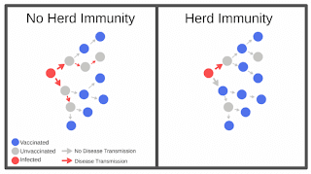
Herd/Community/Group Immunity
Herd Immunity happens when a large percentage of the population are immuned (via vaccination or natural infection) to a disease
Chain of transmission is broken but creating a gap between uninfected and infected by immunised individuals.
  Slows down or stop the disease from spreading to uninfected persons
2021-World immunology day
2021-World immunology day

Slide 43

Herd/Community/Group immunity
Herd immunity is not a physical barrier but a natural unseen phenomenon which creates wide gap between many immunised persons and few un-immunised persons.
Protective herd immunity in one community may not be protective in another community.
My view: As at now, achieving herd immunity is possible but might not be easy.
2021-World immunology day

Slide 44
Conclusion
As at now, achieving herd immunity for COVID-19 is possible but a difficult task.
Knowledge about COVID-19 vaccine is still emerging.
Use of non-pharmacological protective measures should still be ensured even after massive vaccination.
Boosting immunity and practising hygienic lifestyle is advised.
Winning the war against COVID-19 is a responsibility of EVERYBODY.
2021-World immunology day

Slide 45
FURTHER READING
Arinola O.G (2020). Immune Responses During Human Coronavirus Infection: Suggestions For Future Studies: Nigerian Journal of Physiological Sciences. 35: 20-25 (Review).
Arinola O.G (2020). Pressure is on to develop a COVID-19 vaccine, but corners can't be cut”. The Conversation. https://theconversation.com/pressure-is-on-to-develop-a-covid-19-vaccine-but-corners-cant-be-cut-141219
Arinola O.G (2020). COVID-19: Easing lockdown ‘ll not provide herd immunity- Expert. https://www.vanguardngr.com/2020/05/covid-19-easing-lockdown-ll-not-provide-herd-immunity-expert/
Arinola O.G (2021). COVID-19 vaccination: Scientists caution FG - Vanguard News. ttps://www.vanguardngr.com/2021/01/covid-19-vaccination-scientists-caution-fg
2021-World immunology day

Slide 46


2021-World immunology day

